Slide 1
Introduction to Bluemix Workshop @ Radford University, October 18 – 19, 2016 http://radford-workshop.mybluemix.net https://github.com/evkortright/bluemix-workshop.git Enrique V. Kortright, Ph.D. – Senior Academic Program Manager / Executive IT Architect

Slide 2

Computer scientists @IBM invent the future

Slide 3
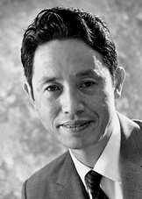
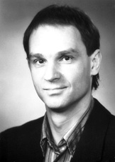
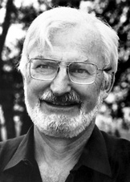
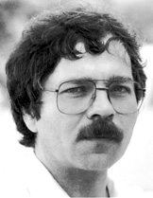
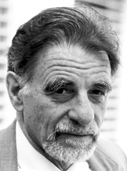
Five IBMers have won Nobel Prizes
Leo Esaki won the 1973 Nobel Prize in Physics in recognition of his pioneering work on electron tunneling in solids.
Gerd Binning and Heinrich Rohrer won the 1986 Nobel Prize in Physics in recognition of for their design of the scanning tunneling microscope.
J. Georg Bednorz and K. Alexander Müller won the 1987 Nobel Prize in Physics for their important break-through in the discovery of superconductivity in ceramic materials.

Slide 4
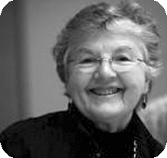
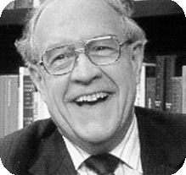
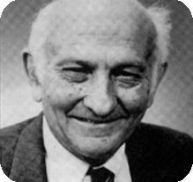
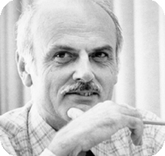
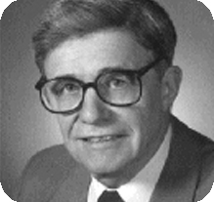
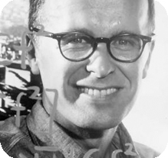
Six IBMers have won Turing Awards
Frances Elizabeth ("Fran") Allen won the 2006 Turing Award for her pioneering contributions to the theory and practice of optimizing compiler techniques that laid the foundation for modern optimizing compilers and automatic parallel execution.
Frederick ("Fred") Brooks won the 1999 Turing Award for his landmark contributions to computer architecture, operating systems, and software engineering.
John Cocke won the 1987 Turing Award for his significant contributions in the design and theory of compilers, the architecture of large systems and the development of reduced instruction set computers (RISC). .
Edgar F. ("Ted") Codd won the 1981 Turing Award for his fundamental and continuing contributions to the theory and practice of database management systems.
Kenneth E. ("Ken") Iverson won the 1979 Turing Award for his pioneering effort in programming languages and mathematical notation resulting in APL, for his contributions to the implementation of interactive systems, to educational uses of APL, and to programming language theory and practice.
John Backus won the 1977 Turing Award for his profound, influential, and lasting contributions to the design of practical high-level programming systems, notably through his work on FORTRAN, and for seminal publication of formal procedures for the specification of programming languages.

Slide 5
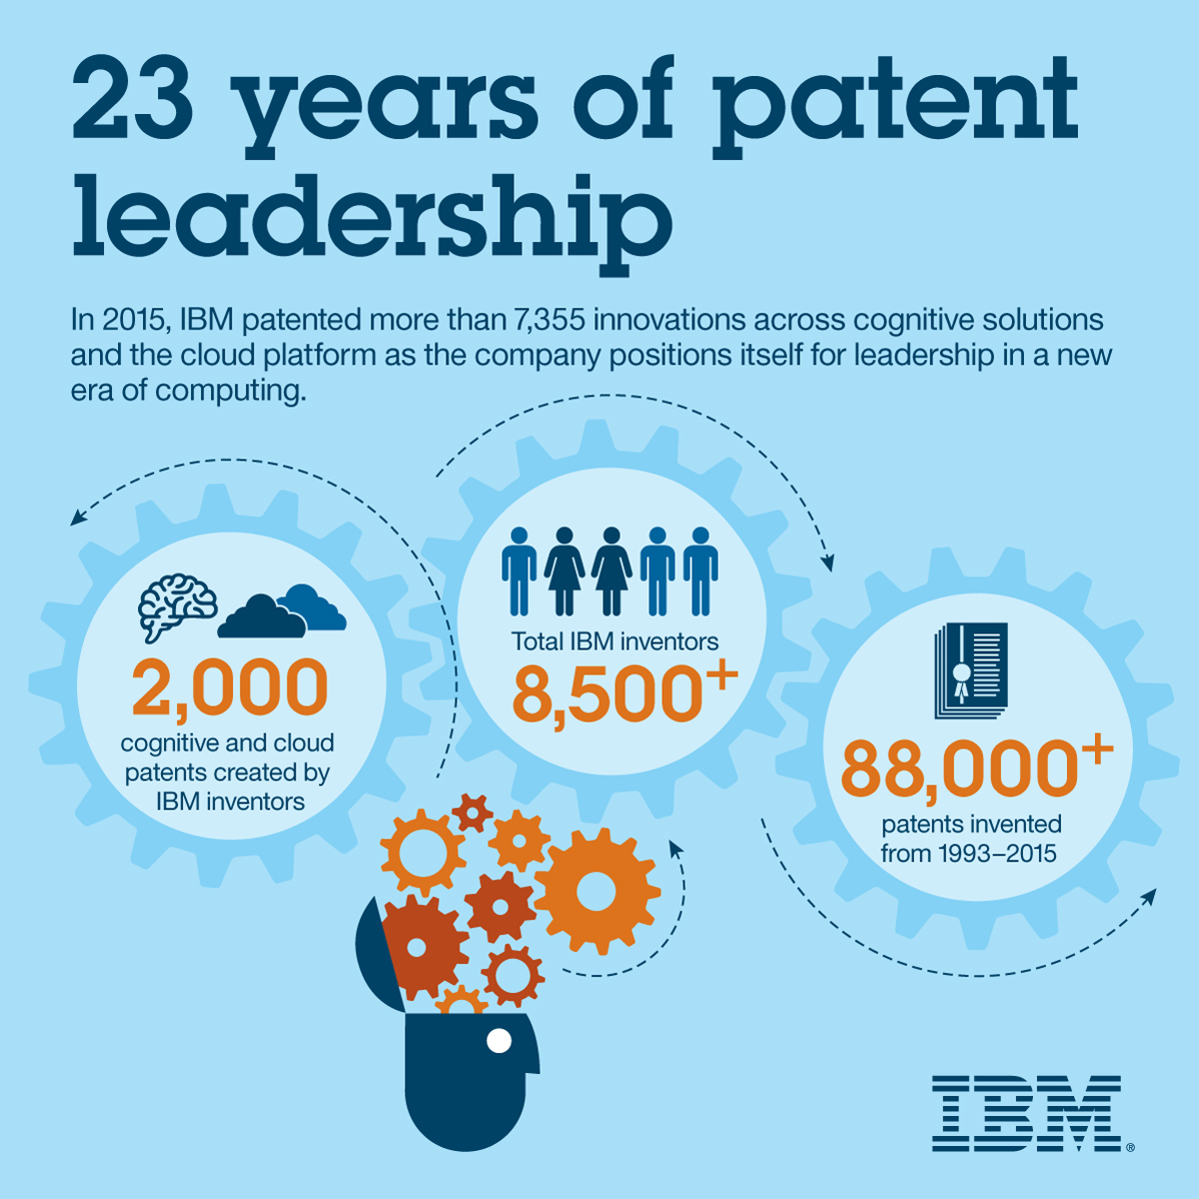
@IBM everyone can be an inventor

Slide 6
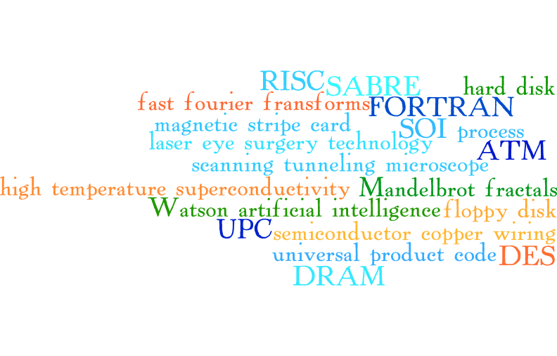
Notable Inventions by IBMers http://www-03.ibm.com/ibm/history/ibm100/us/en/icons/

Slide 7
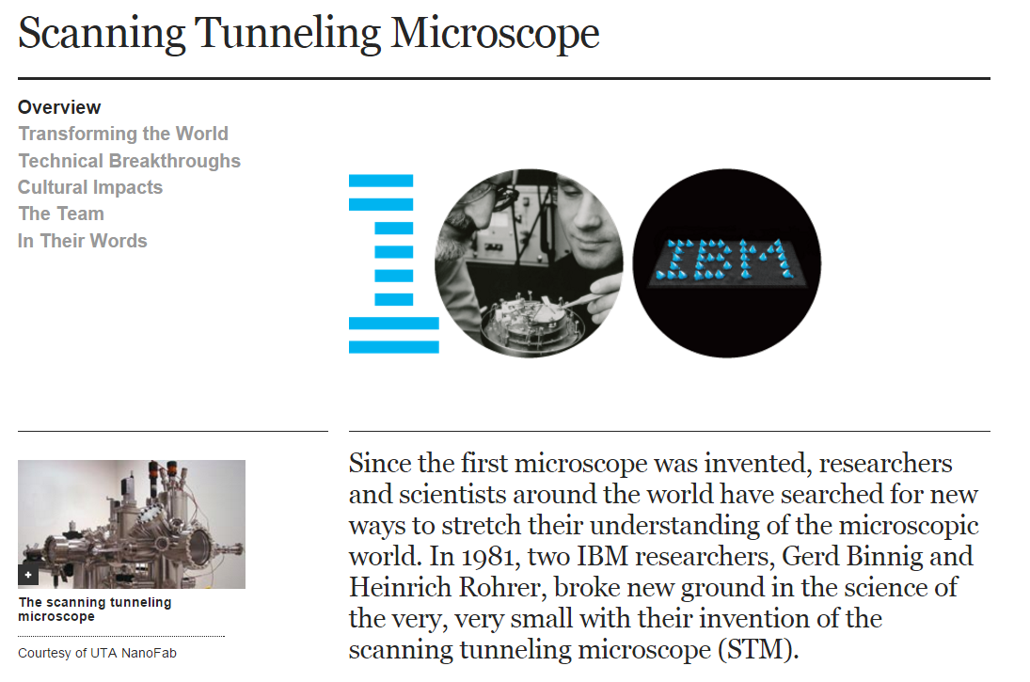

Slide 8
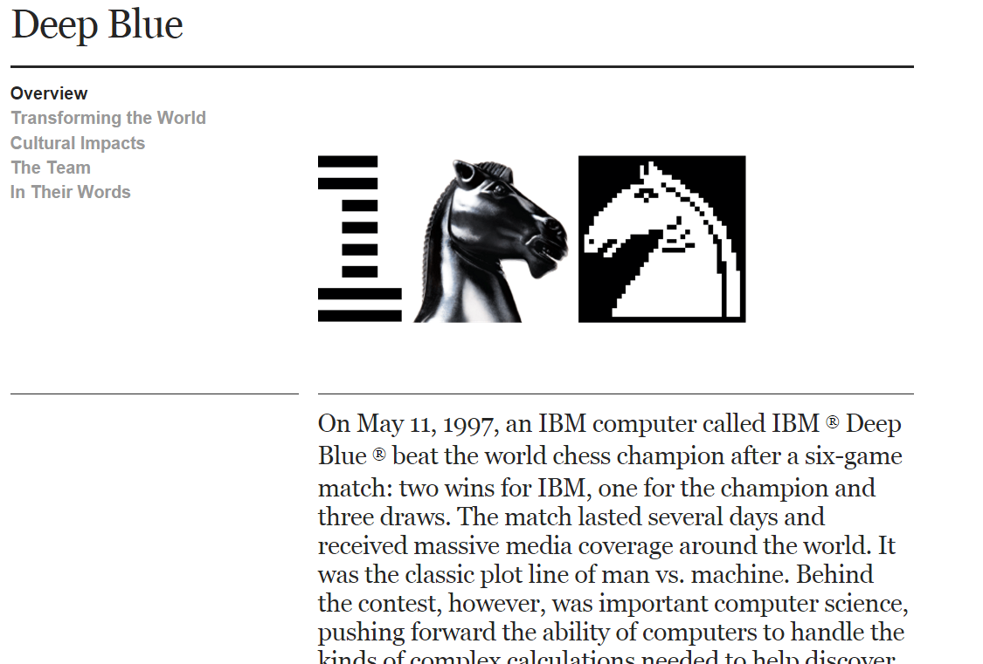

Slide 9
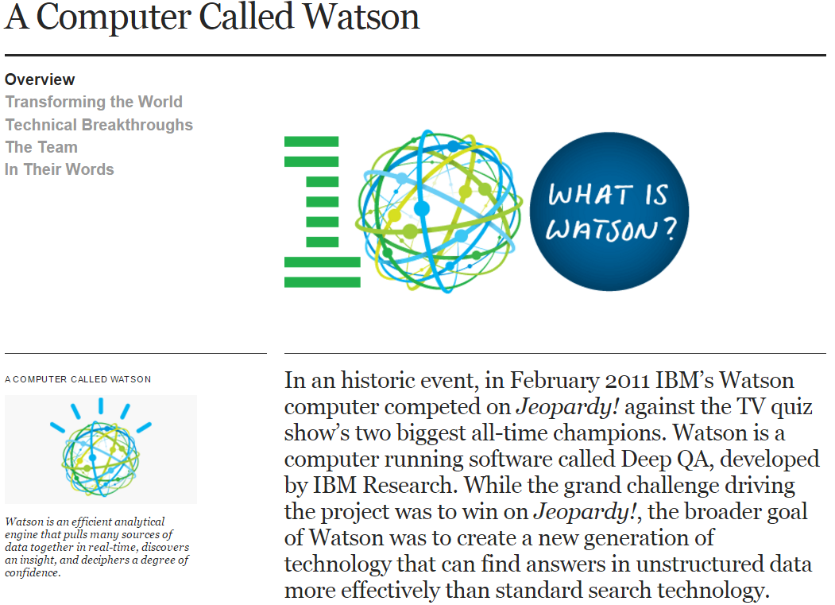

Slide 10
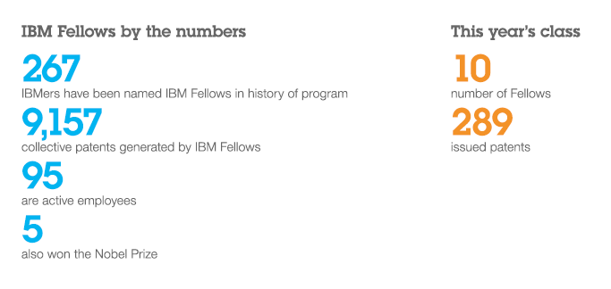
IBM Fellows are our top technical talent

Slide 11
A small sample of IBM Fellows
Carol A. Jones
(2006)
WebSphere Application Server
WebSphere Portal
WebSphere Studio
John Casey
(2013)
Power 7+ chip
High performance glass ceramic
Tech ambassador to Ethiopia
Donald Chamberlin
(2003)
Co-inventor of SQL
Influenced the creation of Xquery
Programming contest judge
IBM’s Tech
Ambassadors
Mark A. Auslander
(1991)
Programming languages
System design
RISC architectures
Anthony A. Storey
(2002)
CICS
MQ Series
EJB spec
Source: If applicable, describe source origin

Slide 12
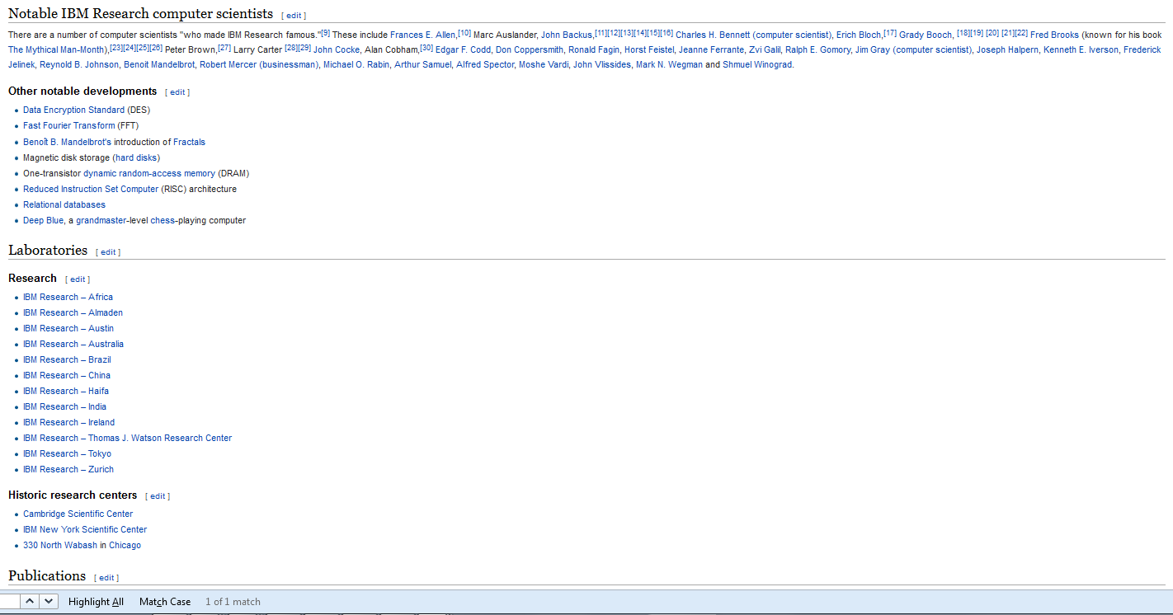
Computer science @IBM is practiced in twelve research labs – and all across the organization

Slide 13
Some of the Latest Innovations @IBM

Slide 14
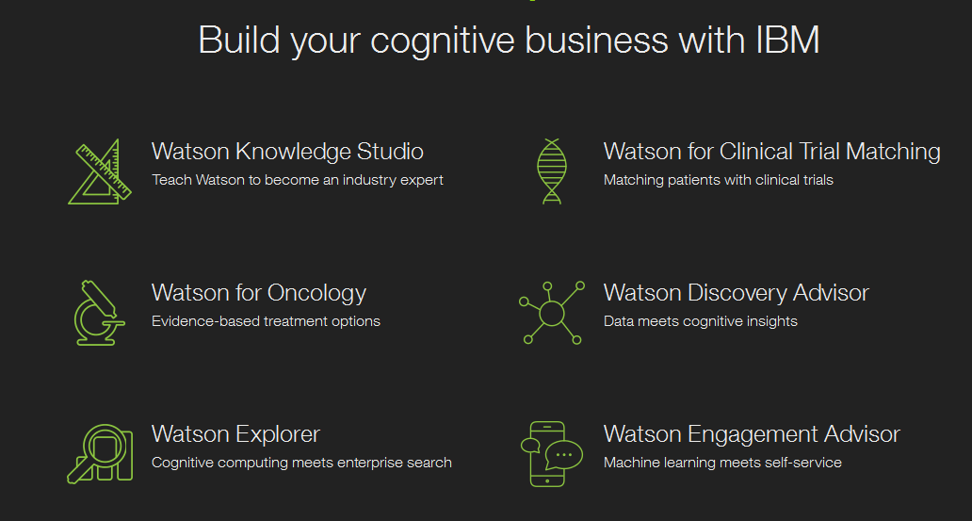
The Cognitive Era

Slide 15
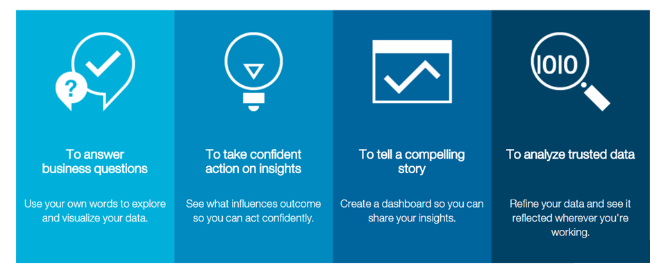
Watson Analytics

Slide 16
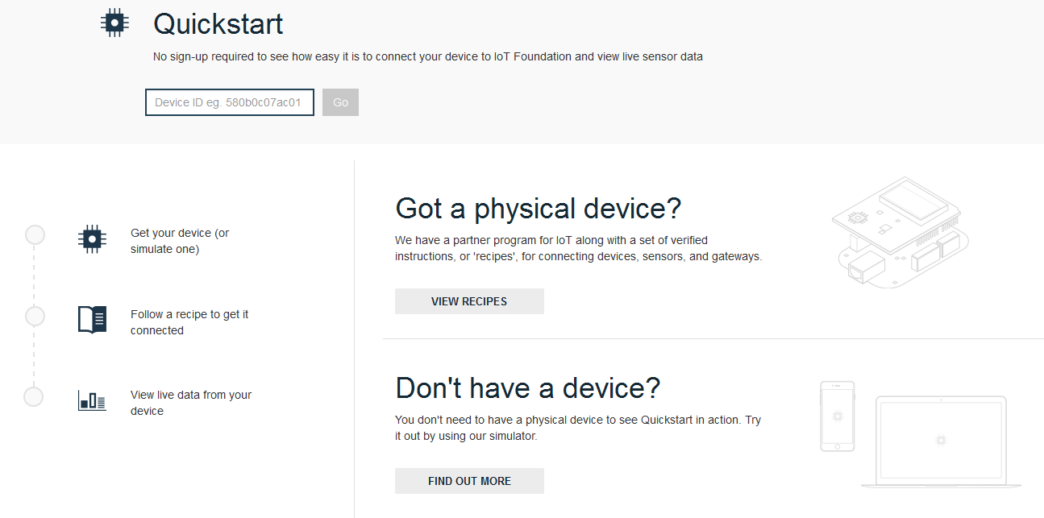
The Internet of Things

Slide 17
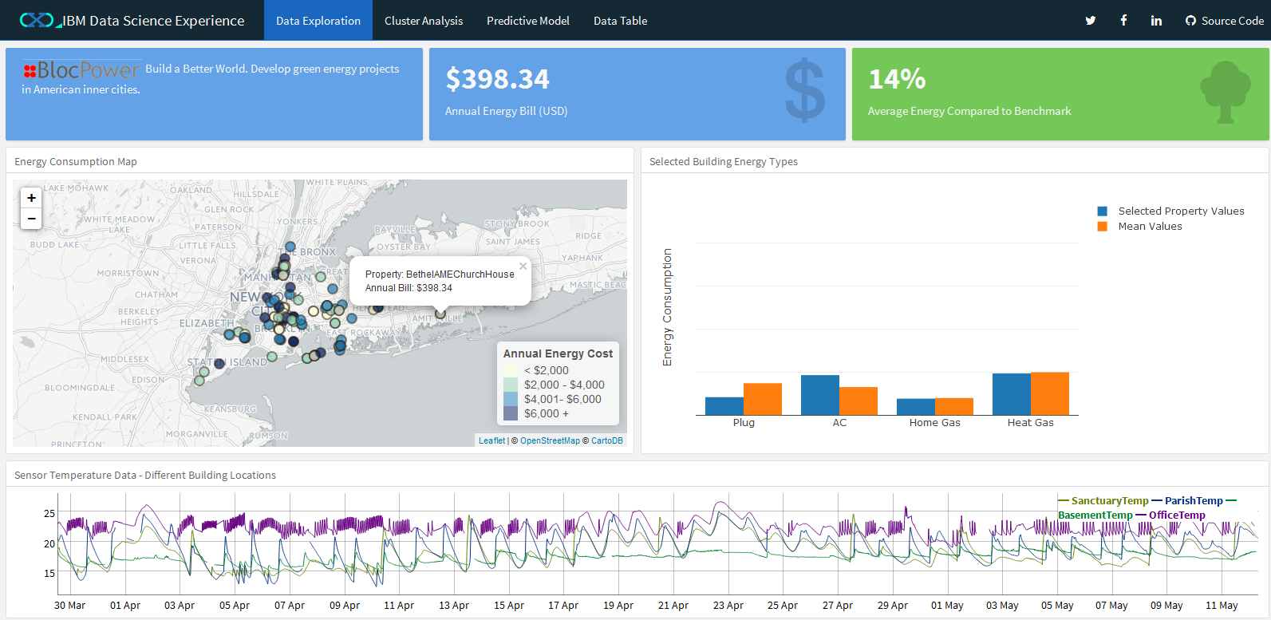
The Data Science Experience: Data Exploration
Notes:
https://apsnginxrstudio.mybluemix.net/node2/rstudio40507/?view=rmarkdown

Slide 18
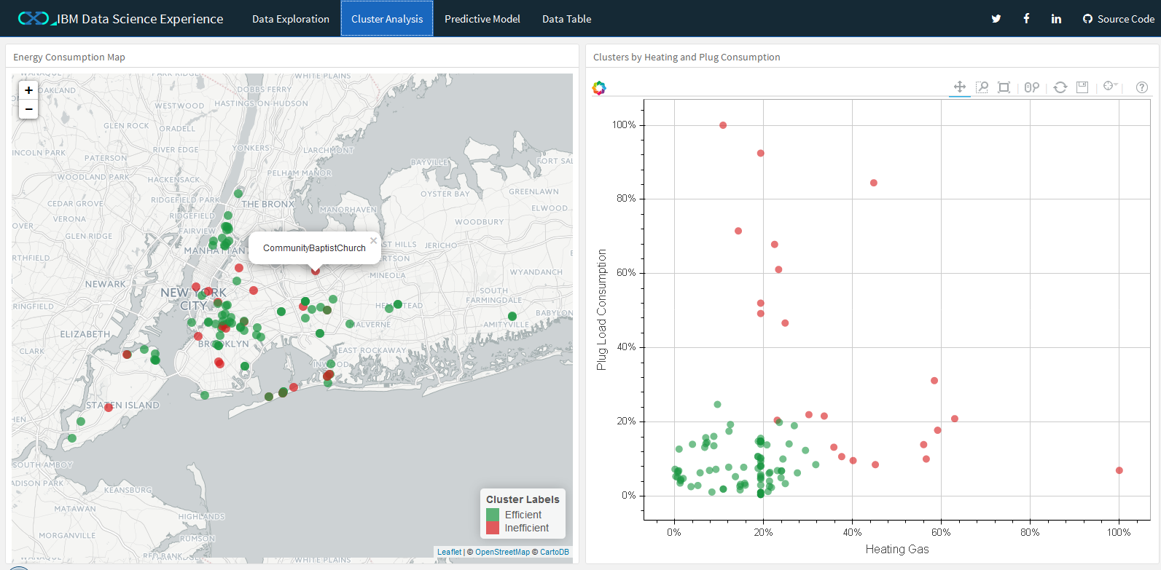
DSX: Cluster Analysis
Notes:
https://apsnginxrstudio.mybluemix.net/node2/rstudio40507/?view=rmarkdown

Slide 19
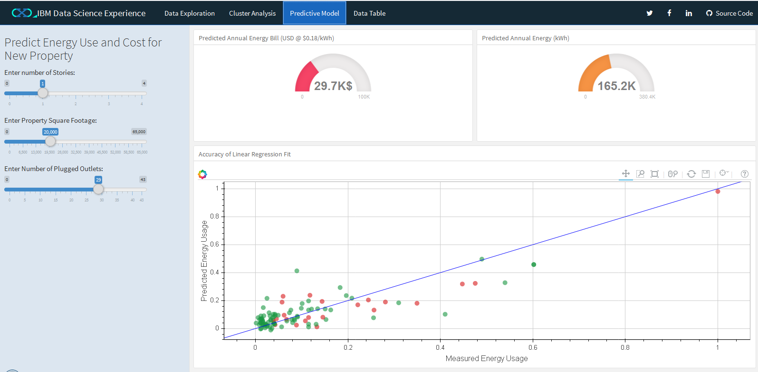
DSX: Predictive Model
Notes:
https://apsnginxrstudio.mybluemix.net/node2/rstudio40507/?view=rmarkdown

Slide 20
Bluemix: an open innovation and invention platform for computer scientists

Slide 21
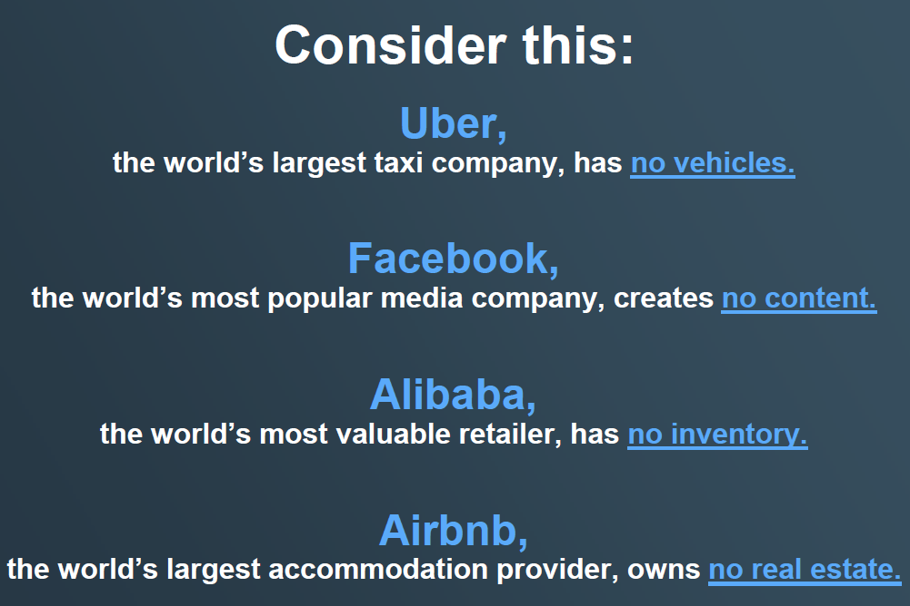

Slide 22
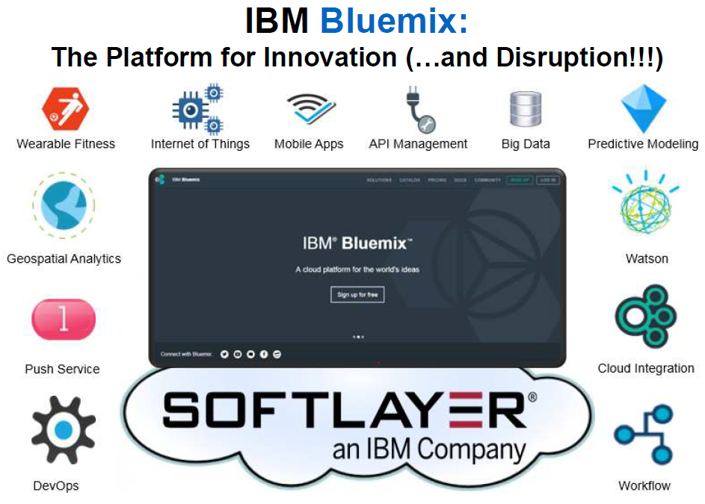
Notes:
From Graham Churchill’s http://www.slideshare.net/ibmcanada/bluemix-innovationplatform

Slide 23
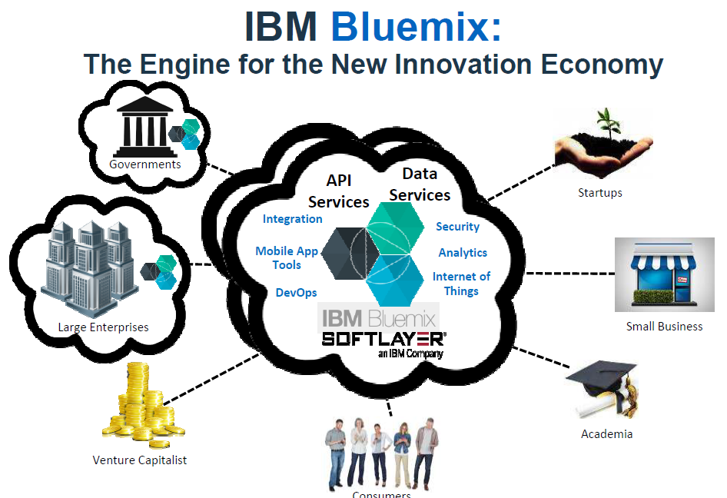
Notes:
From Graham Churchill’s http://www.slideshare.net/ibmcanada/bluemix-innovationplatform

Slide 24
Bluemix Workshop

Slide 25
Outline:
Login to Bluemix
Use the Node.js / Cloudant boilerplate
Try out the starter project on Bluemix
Add Git to the project
Explore Bluemix DevOps
Clone to your desktop
Install node on your desktop (optional)
Try out the project on your desktop
Change the code to find VCAP_SERVICES on your desktop
Make changes, test them locally and push them using Git
Watch the BUILD / DEPLOY pipeline
Test the project on Bluemix
Add code to call a REST API
Use Node-RED for prototyping with Bluemix services
Explore a smart chat app

Slide 26
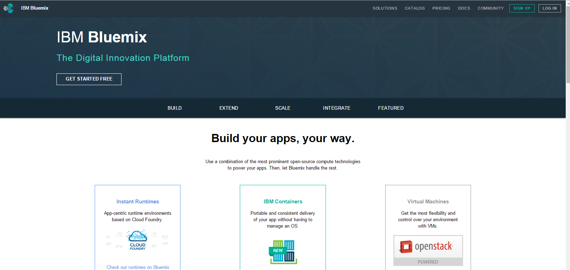
Login with an IBM ID

Slide 27
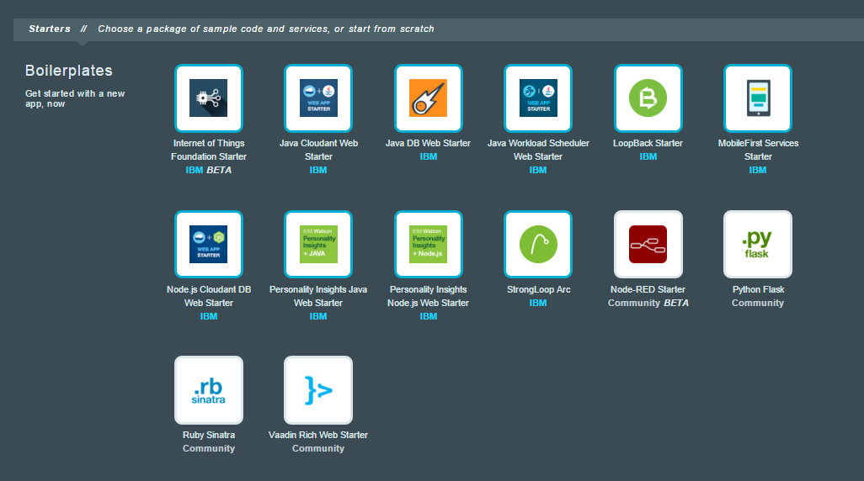
Choose the Node.js Cloudant DB Web Starter boilerplate from the Catalog

Slide 28
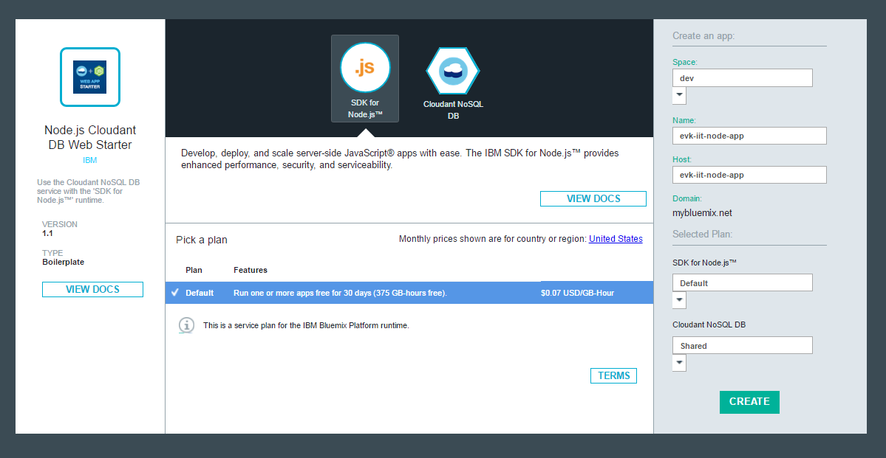
Enter name for the app and click CREATE

Slide 29
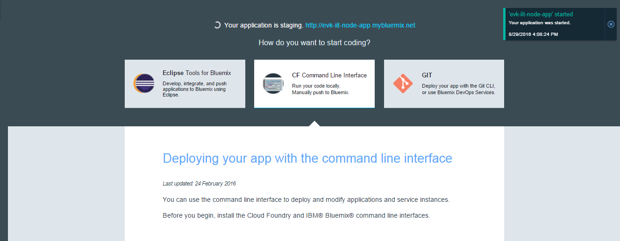
Wait for the app to stage

Slide 30
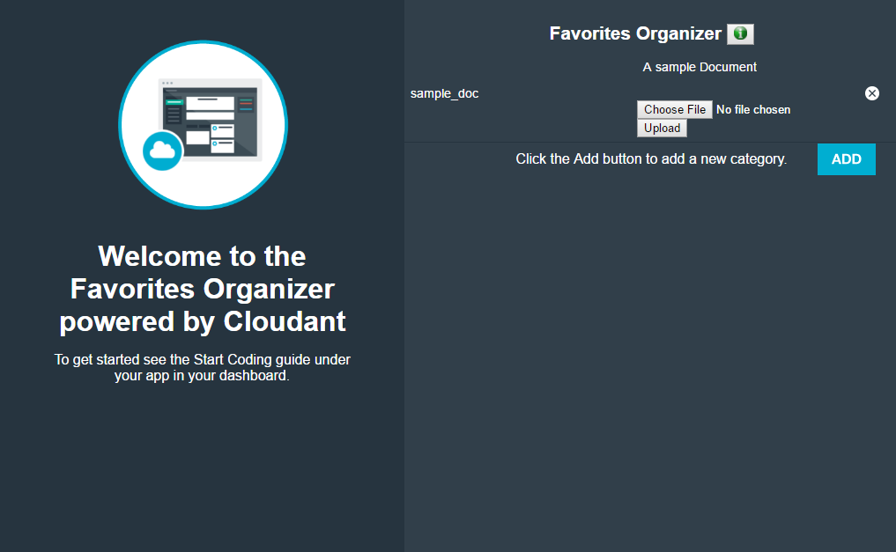
Click the app’s URL and explore the starter app

Slide 31
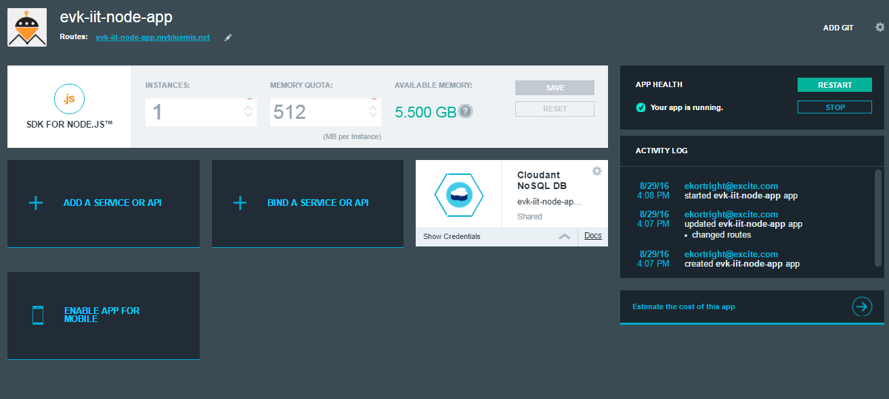
Click Overview to see the app’s dashboard. Note the Cloudant NoSQL DB service binding

Slide 32
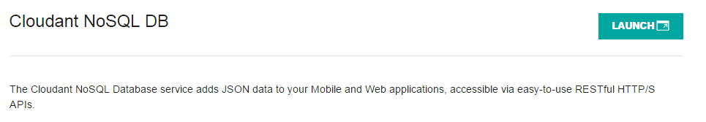
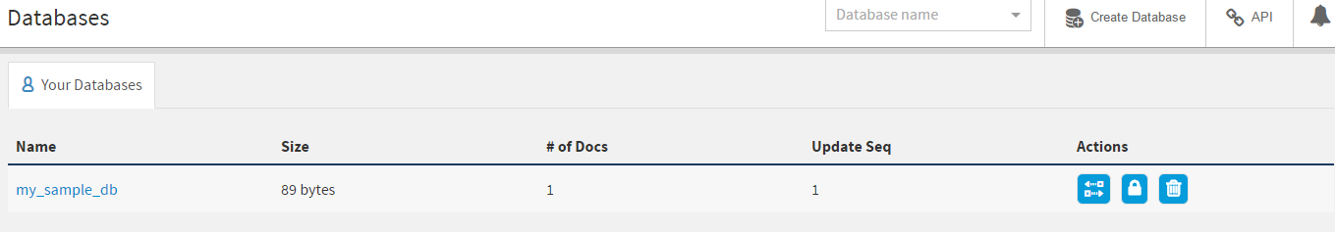
Click on the Cloudant box and launch and LAUCH the console.

Slide 33
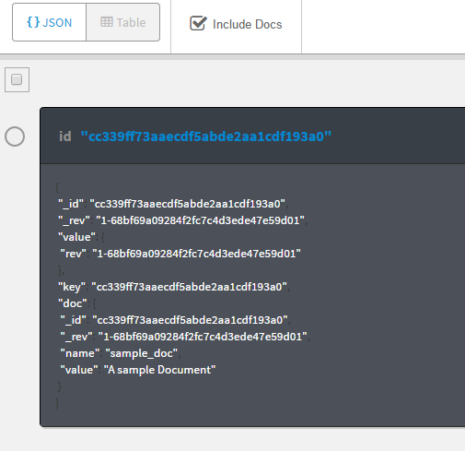
Open the my_sample_db and explore its contents.

Slide 34
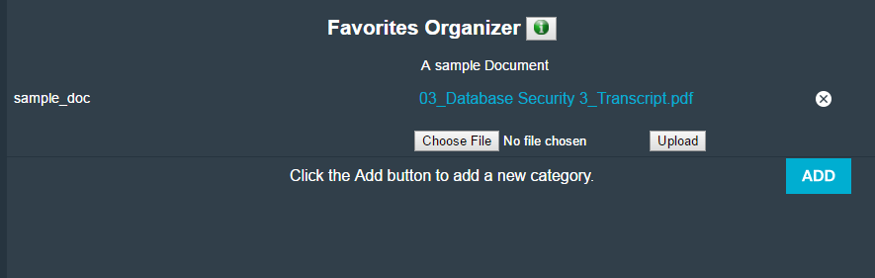
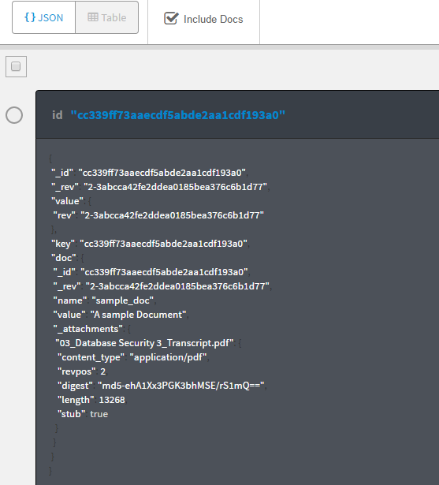
Make a change using the app and view the change on Cloudant.

Slide 35
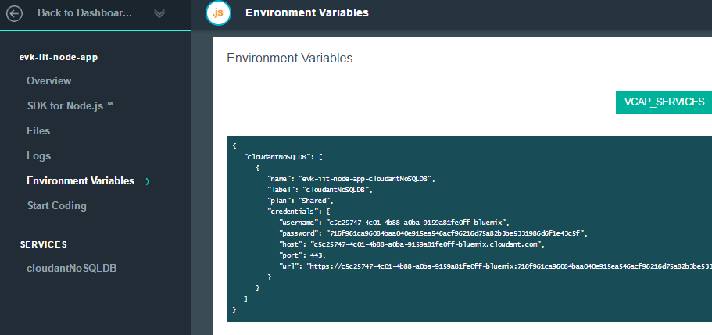
In Bluemix, click on Environment Variables and study the VCAP_SERVICES variable containing the Cloudant credentials.

Slide 36
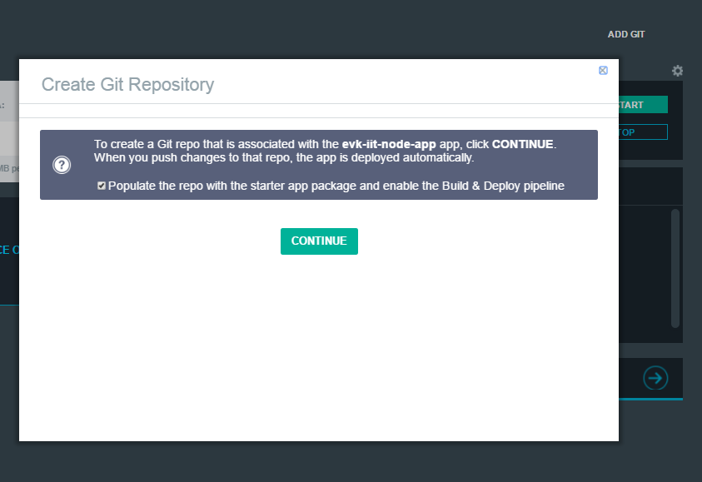
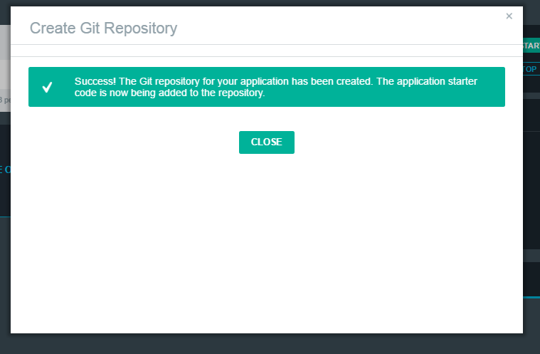
To start coding, from the Overview, add Git to the project. Make sure Populate the repo is checked. Click CONTINUE.

Slide 37
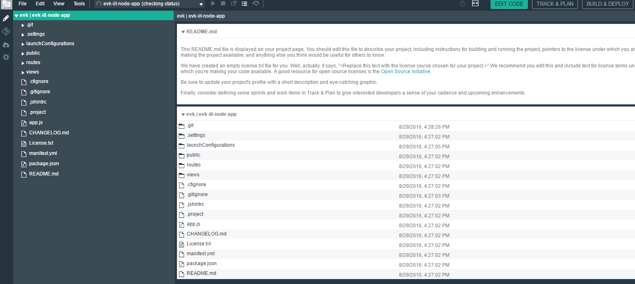
Click EDIT CODE to go to Bluemix DevOps. Wait for the workspace to be setup and populated with the starter code.

Slide 38
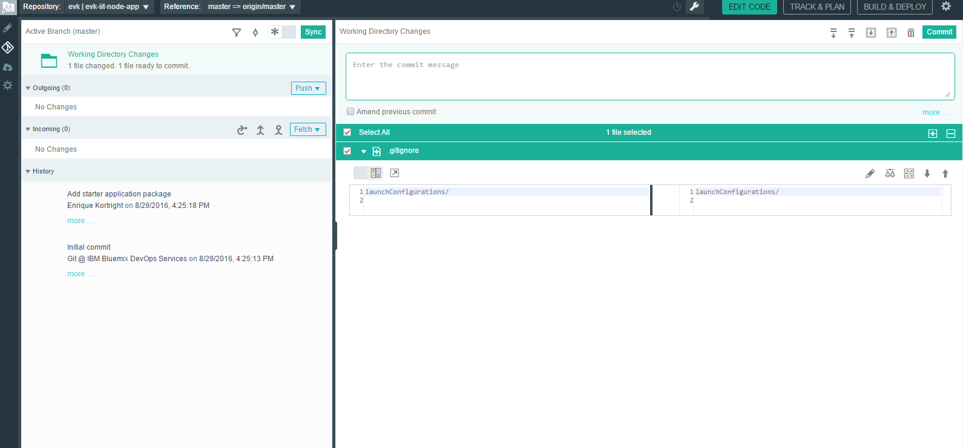
Click the Git icon to setup the repository.

Slide 39
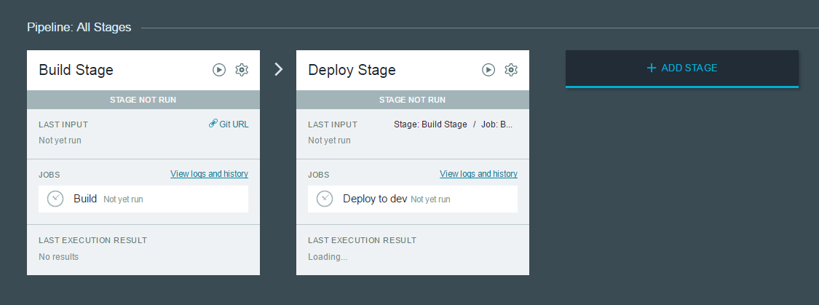
Click on BUILD & DEPLOY to view the pipeline

Slide 40
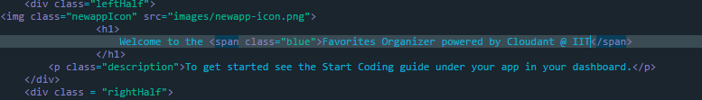
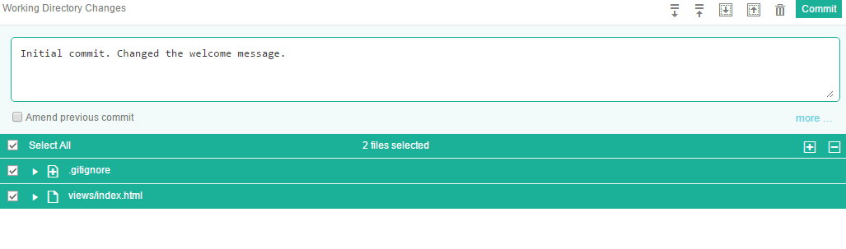
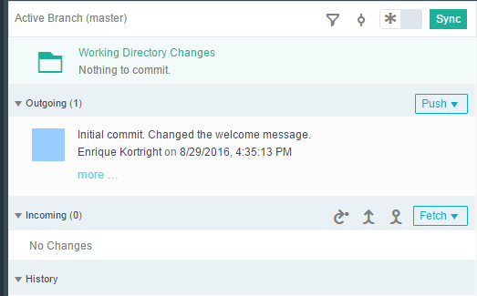
Make a change to the project, commit and push the change, watch the pipeline, and test the change.

Slide 41
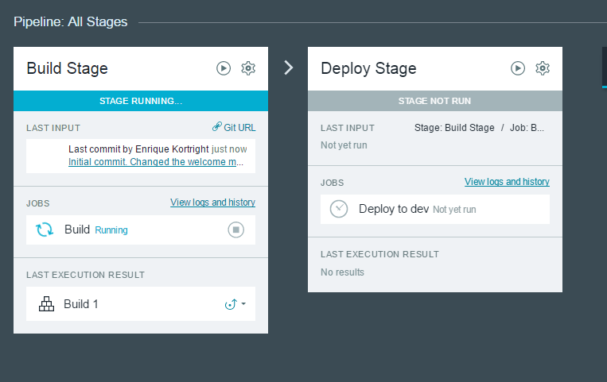
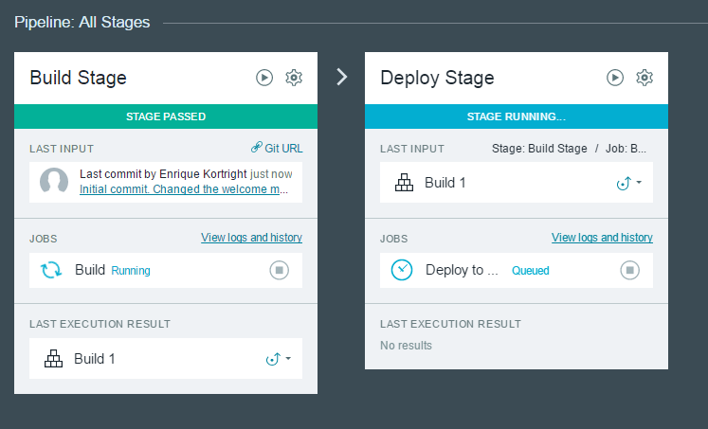
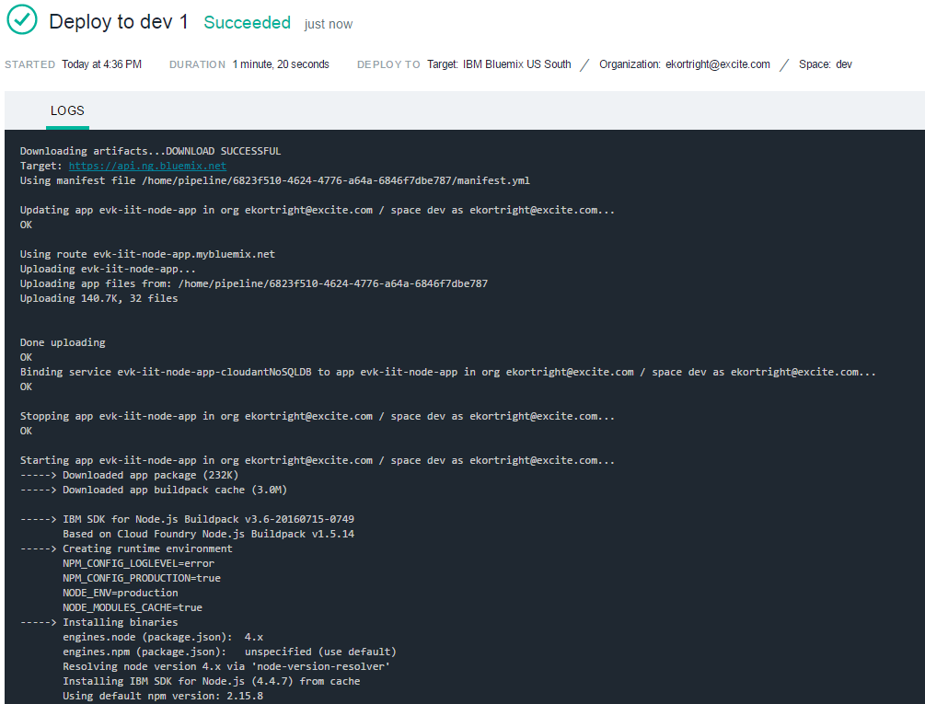


Slide 42

Refresh the browser to test the change.

Slide 43

Optional: Clone the app repository to your desktop using Git. Make changes to the app and test locally. Commit and push the changes. Watch the BUILD&DEPLOY pipeline on Bluemix DevOps. Test the app.

Slide 44

Next Steps: Try TRACK&PLAN

Slide 45
How to quickly explore and prototype with Node-RED

Slide 46
Choose the Node-RED boilerplate from the Catalog

Slide 47

Give the app a name and click CREATE
Notes:
The app name is the same as the host name. In this case abc-smart-chat

Slide 48

Wait for the app to finish staging and click on the URL to open it
Notes:
A Node-RED runtime will be created and deployed with a binding to a Cloudant service

Slide 49

Click on the button to go to the Node-RED flow editor

Slide 50

Now we are ready to invent!
Notes:
The Node-RED editor can always be found at http://abc-smart-chat.mybluemix.net/red/

Slide 51






Explore the nodes
Notes:
The palette can be enhanced by downloading the app, adding nodes and pushing it back to Bluemix

Slide 52

Double-click on the tab to rename the Flow

Slide 53

From the palette, drag, drop and connect an http-in, http-out and a template node in that order
Notes:
To connect nodes, clock on a node output (the gray circle) and drag to the next node’s input

Slide 54

Double-click the http-in node, set the method to GET and the route to /hello-world

Slide 55


Deploy the app and watch for any problems

Slide 56

Now, try it out by opening abc-smart-chat.mybluemix.net/hello-world in a new browser window
Notes:
It’s a good idea to test every step in its default state before adding configuration or code

Slide 57

Double-click on the template node and add a hello-world greeting in HTML

Slide 58

Deploy the app and refresh the /hello-world page
Notes:
With just three nodes (per route) we have an instant web server hosted on IBM’s Bluemix Cloud

Slide 59

Change the template to have a form with an input

Slide 60

Now add the /greet route with method GET
Notes:
Template nodes use the moustache template syntax
{{ req.query.name }} matches the ‘name’ parameter from the URL (/greet?name=Joe)

Slide 61

Deploy the app, refresh the hello-world page, enter your name and press <ENTER>

Slide 62


Create a new tab for the Smart Chat
Notes:
Remember to double click the tab name to rename to Smart Chat

Slide 63

Build a new route /chat with method GET and the shell of the chat page

Slide 64

Style the page with CSS
double-click to see the
complete CSS
Notes:
Double click inside the orange rectangle to open a WordPad document containing the complete CSS and add to the bottom of the template node.

Slide 65

Redeploy and open the /chat route. Try the Send button.

Slide 66



Send the message using web sockets. Drop a pair of websocket nodes (in and out) and configure the them to listen on /ws/chat.
Notes:
From the palette, select and hook up a pair of websocket nodes. Double-click the input websocket node to configure it.
Use the pencil icon to add the listener.
Configure the out node, as well by double-clicking on it and accepting the default.

Slide 67

Add code to create the socket connection and handle events

Slide 68

Deploy the app, refresh the /chat page, and verify that a connection is made in the Node-RED window.

Slide 69

Change the code to send the message using the socket.

Slide 70

Verify that the message goes through the socket.

Slide 71

Open two browser windows with the /chat route. Note that the message stays in the origin window.

Slide 72

Fix that by deleting the session information using a function node.

Slide 73

Verify that both windows receive the message.

Slide 74

Remove the alert statements (with comments //) and display the chat in the chat box

Slide 75

The simple version of the chat app is complete.

Slide 76

To hold the conversation in French, drop a Watson language translation node and modify the websocket flow.
Notes:
French is the default. Spanish also works well under the Standard plan.

Slide 77

The first function node saves the payload and extracts the message to pass as a new payload to the Watson translation node.

Slide 78

The second function node restores the original payload, substituting the message with its translation.

Slide 79

The chat will not work because the Watson translation service has not been bound to the app in Bluemix. Do that now.

Slide 80

From the Catalog, pick Watson Language Translation and click CREATE.

Slide 81

Restage the app

Slide 82

Refresh the Node-RED editor (the /red route) and the /chat window. Now Watson translates the chat into French.

Slide 83

Now add vision abilities to the Smart Chat. Start by binding the Watson Visual Recognition service to the app in Bluemix.

Slide 84

Modify the flow in Node-RED to switch to visual recognition when the payload starts with http. (restage the app and refresh /red)
Notes:
Note that each rule goes a a node output.

Slide 85

Add a Watson Visual Recognition node to the flow using switch output #1.

Slide 86

Next, add a function node that verbalizes the output of the visual recognition node.

Slide 87

Connect the Verbalize node so that it’s output is also translated.

Slide 88

Finally, add code to display the picture that Watson is looking at.

Slide 89

Now Watson helps Smart Chat translate a conversation and understand the content of an image.

Slide 90

Let’s add IoT notifications to the chat. Go to https://quickstart.internetofthings.ibmcloud.com/iotsensor/ to emulate an temperature sensor. Note the device id.

Slide 91

Add an ibmiot node to the Smart Chat flow and confiture it with the device id.

Slide 92

Exercise: Debug the IoT node and observe the message contents. Add a sub-flow that inserts a message into the chat whenever a temperature change is detected.

Slide 93
Credits and References
The chat app is based on the DeveloperWorks tutorial by Luiz Gustavo Ferraz Aoqui and Bradley Steinfeld (http://www.ibm.com/developerworks/cloud/library/cl-rtchat-app/)
IBM Bluemix: The Digital Innovation Platform, Graham Churchill http://www.slideshare.net/ibmcanada/bluemix-innovationplatform
IBM Research, Wikipedia https://en.wikipedia.org/wiki/IBM_Research

Slide 94
More about the IoT on Bluemix

Slide 95


Third Party Apps
Third Party Apps
IBM IoT Foundation offerings
IBM IoT Foundation Connect
Attach, Collect & Organize, Device Management, Secure Connectivity, Visualization
IBM IoT Foundation Information Management
Storage & Archive, Metadata Management, Reporting, Streaming data, Parsing and Transformation, Manage unstructured data
IBM IoT Foundation Analytics
Predictive, Cognitive, Real-time, and Contextual
IBM IoT Foundation Risk Management
Security Analytics, Data Protection, Auditing/Logging, Firmware Updates, Key/Cert Mgmt, Org Specific Security
https://internetofthings.ibmcloud.com/#/

Slide 96

Over 120 Services and APIs in Bluemix Catalog at https://console.ng.bluemix.net/catalog/
Use the “Internet of Things Platform Starter” to get started with your IoT application
Notes:
IBM Bluemix is a cloud platform as a service offering
It supports several programming languages and services as well as integrated DevOps to quickly and easily build, run, deploy and manage applications on the cloud.
Bluemix is based on Cloud Foundry open technology and runs on SoftLayer infrastructure.
Bluemix delivers enterprise-level services that can easily integrate with your cloud applications without you needing to know how to install or configure them.

Slide 97
Five keys to tap into IoT value
Connect to and control devices
Collect and manage IoT data
Understand the data and analyze
Act and react based on the analysis
Build applications to harness the potential
Notes:
97

Slide 98








developerWorks Recipes Ecosystem & partnership strategy extend the IBM IoT platform
Devices & Networks
https://developer.ibm.com/recipes/
Derive IoT value on the Cloud through strong industry partnerships and open ecosystem
Connecting Devices to the IBM IoT platform:
Wide variety of supported devices
Self Service
Open ecosystem
Simple tutorials
Connect in moments
Examples:

Slide 99


Slide 100


Slide 101


Slide 102



IoT drives Industry
 | Banking | Healthcare | Automotive | Retail | Transport | E&U
Monetize | Cash replacement solutions Mobile banking | Paid home care family services | Pay-per-drive car rental | Cash replacement Sensor-enabled loyalty cards | Paid alerts to travellers Congestion charging | Pay-per-use energy
Optimize | Optimized cash management | ER bed resource mgmt | Component predictive replacement Fleet mgmt | Delivery and stock replenishment optimization Store layout optimization | Smart Cities Traffic mgmt Airport Management | Delay non-essential supply during peak loads
Extend | Banking the un-banked Biometrics Smarter Subsidies | Life style monitoring | In-car Movies, Music, Games Highly Automated Driving | Smart Vending Machines Delivery Lockers | Mobility Services | Smart home services
Control | Remote ATM management Dynamic Authorization | Remote hospital environment Mgmt | Remote drive-train optimization | Store energy mgmt Store parking mgmt Dynamic price labels | Crowd mgmt Timetable mgmt Asset mgmt | Remotely control consumer devices
$
$
$

Slide 103
IBM IoT Resources
Educator’s Guide: IBM Academic Initiatives IoT Educator’s Guide
Key online courses:
Getting Started with IBM Bluemix
IBM Watson IoT Academy
Getting started:
Watson IoT Homepage
Watson IoT platform page
Watson IoT developers page
DeveloperWorks Recipes to connect your devices to the Bluemix cloud
Play with our sample app
Quickstart with your smartphone
Use the simulated device and sensors to experience the IBM Watson IoT Platform
Demo:
Intro to Bluemix and Internet of Things Foundation - Part 1
Intro to Bluemix and Internet of Things Foundation - Part 2
Connected Car
IBM IoT overview and Connected Car demo
Smart Buildings with Sogeti (Recorded)
Smart Buildings with Sogeti (Manual; password: sogetiibm)
Bluemix and Internet of Things
IBM Python app with a Raspberry Pi and Bluemix
Tutorial:
IoT Python app with a Raspberry Pi and Bluemix
Build a connected-car IoT app with Geospatial Analytics
Whitepaper:
Is your business ready for the Internet of Things
Four ways to drive service innovation with the Internet of Things
Deriving business value from the Internet of Things
The rise of the machine data - Are you prepared?
IBM MessageSight in the Automotive Industry
IBM Point of View: Internet of Things Security
Redbook: The Interconnecting of Everything

Slide 104
Opportunities @IBM

Slide 105
Internships and other opportunities @IBM
Visit http://www.ibmcampusus.com/ and click on Intern and Co-Op Opportunities.
http://www.ibmcampusus.com/ is also a great place to search for jobs!

Slide 106

Extreme Blue 12-week internship http://www-01.ibm.com/employment/us/extremeblue/index.html

Slide 107

Ph.D. Fellowships and other awards @IBM http://www.research.ibm.com/university/awards/phdfellowship.shtml

Slide 108


Slide 109
Legal Disclaimer
© IBM Corporation 2015. All Rights Reserved.
The information contained in this publication is provided for informational purposes only. While efforts were made to verify the completeness and accuracy of the information contained in this publication, it is provided AS IS without warranty of any kind, express or implied. In addition, this information is based on IBM’s current product plans and strategy, which are subject to change by IBM without notice. IBM shall not be responsible for any damages arising out of the use of, or otherwise related to, this publication or any other materials. Nothing contained in this publication is intended to, nor shall have the effect of, creating any warranties or representations from IBM or its suppliers or licensors, or altering the terms and conditions of the applicable license agreement governing the use of IBM software.
References in this presentation to IBM products, programs, or services do not imply that they will be available in all countries in which IBM operates. Product release dates and/or capabilities referenced in this presentation may change at any time at IBM’s sole discretion based on market opportunities or other factors, and are not intended to be a commitment to future product or feature availability in any way. Nothing contained in these materials is intended to, nor shall have the effect of, stating or implying that any activities undertaken by you will result in any specific sales, revenue growth or other results.
If the text contains performance statistics or references to benchmarks, insert the following language; otherwise delete: Performance is based on measurements and projections using standard IBM benchmarks in a controlled environment. The actual throughput or performance that any user will experience will vary depending upon many factors, including considerations such as the amount of multiprogramming in the user's job stream, the I/O configuration, the storage configuration, and the workload processed. Therefore, no assurance can be given that an individual user will achieve results similar to those stated here.
If the text includes any customer examples, please confirm we have prior written approval from such customer and insert the following language; otherwise delete: All customer examples described are presented as illustrations of how those customers have used IBM products and the results they may have achieved. Actual environmental costs and performance characteristics may vary by customer.
Please review text for proper trademark attribution of IBM products. At first use, each product name must be the full name and include appropriate trademark symbols (e.g., IBM Lotus® Sametime® Unyte™). Subsequent references can drop “IBM” but should include the proper branding (e.g., Lotus Sametime Gateway, or WebSphere Application Server). Please refer to http://www.ibm.com/legal/copytrade.shtml for guidance on which trademarks require the ® or ™ symbol. Do not use abbreviations for IBM product names in your presentation. All product names must be used as adjectives rather than nouns. Please list all of the trademarks that you use in your presentation as follows; delete any not included in your presentation. IBM, the IBM logo, Lotus, Lotus Notes, Notes, Domino, Quickr, Sametime, WebSphere, UC2, PartnerWorld and Lotusphere are trademarks of International Business Machines Corporation in the United States, other countries, or both. Unyte is a trademark of WebDialogs, Inc., in the United States, other countries, or both.
If you reference Adobe® in the text, please mark the first use and include the following; otherwise delete: Adobe, the Adobe logo, PostScript, and the PostScript logo are either registered trademarks or trademarks of Adobe Systems Incorporated in the United States, and/or other countries.
If you reference Java™ in the text, please mark the first use and include the following; otherwise delete: Java and all Java-based trademarks are trademarks of Sun Microsystems, Inc. in the United States, other countries, or both.
If you reference Microsoft® and/or Windows® in the text, please mark the first use and include the following, as applicable; otherwise delete: Microsoft and Windows are trademarks of Microsoft Corporation in the United States, other countries, or both.
If you reference Intel® and/or any of the following Intel products in the text, please mark the first use and include those that you use as follows; otherwise delete: Intel, Intel Centrino, Celeron, Intel Xeon, Intel SpeedStep, Itanium, and Pentium are trademarks or registered trademarks of Intel Corporation or its subsidiaries in the United States and other countries.
If you reference UNIX® in the text, please mark the first use and include the following; otherwise delete: UNIX is a registered trademark of The Open Group in the United States and other countries.
If you reference Linux® in your presentation, please mark the first use and include the following; otherwise delete: Linux is a registered trademark of Linus Torvalds in the United States, other countries, or both. Other company, product, or service names may be trademarks or service marks of others.
If the text/graphics include screenshots, no actual IBM employee names may be used (even your own), if your screenshots include fictitious company names (e.g., Renovations, Zeta Bank, Acme) please update and insert the following; otherwise delete: All references to [insert fictitious company name] refer to a fictitious company and are used for illustration purposes only.

